Slide 1
SSH
Erich Viebrock
Notes:
This presentation demonstrates the new capabilities of PowerPoint and it is best viewed in Slide Show. These slides are designed to give you great ideas for the presentations you’ll create in PowerPoint 2010!
For more sample templates, click the File tab, and then on the New tab, click Sample Templates.

Slide 2
Outline
1
2
3
Purpose
Applications
Implement
SSH

Slide 3
Purpose in Networking
1
SSH

Slide 4


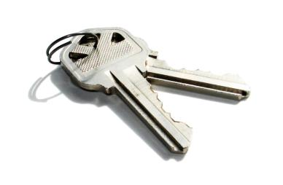
What is SSH?
Cryptographic network protocol for secure data transferring. Also encompasses SCP (Secure Copy) and SFTP (SSH File Transfer Protocol)
Uses public-key cryptography, also known as asymmetric cryptography. Requires a public and private key

Slide 5

Current Applications
2
SSH

Slide 6




SSH is most commonly used for remote access to shell accounts in Unix and Windows based operating systems
SSH was designed to replace Telnet and other insecure remote protocols, which send information (passwords, for example) in plain text, leaving the user in a vulnerable state

Slide 7
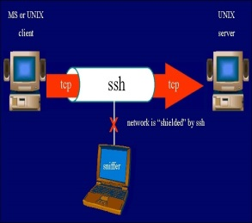

Slide 8


Slide 9
Implement in Software
3
SSH

Slide 10
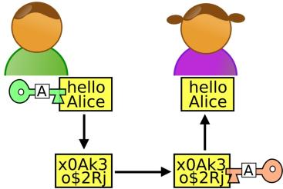
Development₁
Public Key Cryptography is an essential of SSH. Without encrypting data before sending, the user is vulnerable to providing sensitive information to the wrong hands

Slide 11

Development₂
The client and server both need a public and private key. Public keys are sent over the network, but private keys must remain OFF the network

Slide 12
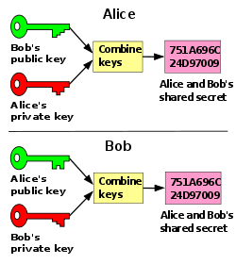
Development₃
By sending a public key ”interlaced” with a private key, and returning a public key interlaced with a private key, a user can interpret another user’s private key

Slide 13
Questions?
?
SSH

